Slide 1
Hypothesis Test

Slide 2
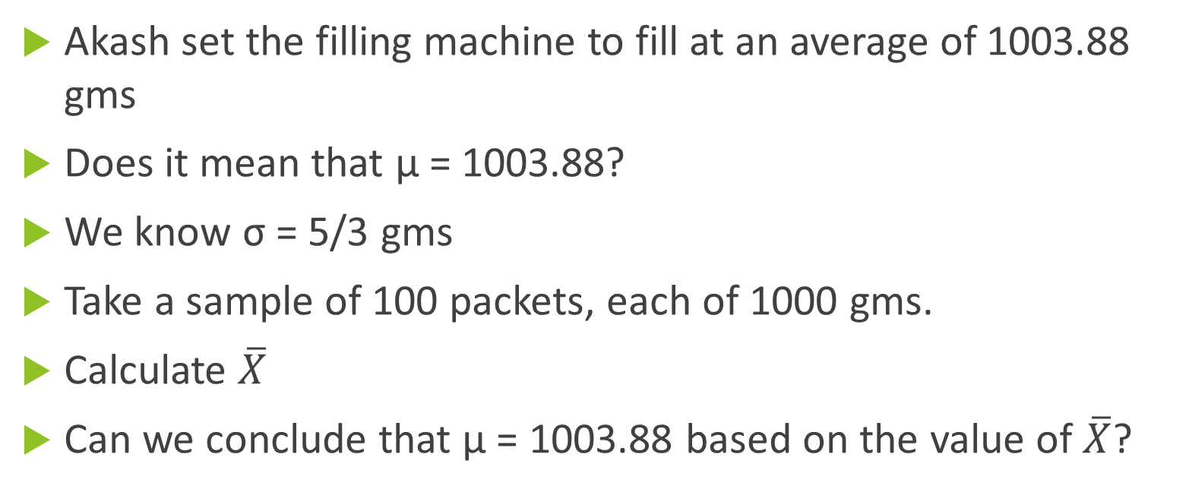
Revisit to “How Much to pack?”
Akash set the filling machine to fill at an average of 1003.88 gms
Does it mean that μ = 1003.88?
We know σ = 5/3 gms
Take a sample of 100 packets, each of 1000 gms.
Calculate $\overline{X}$
Can we conclude that μ = 1003.88 based on the value of $\overline{X}$?

Slide 3

Two possibilities
Based on the value of sample mean
Hypothesis is true | Hypothesis is not True
μ = 1003.88 | μ ≠ 1003.88
Conclude that μ = 1003.88
BAD Decision Type II Error
GOOD Decision
BAD Decision Type II Error Prob = β
BAD Decision
Two More Possibilities
Based on the value of $\overline{X}$
Conclude that μ ≠1003.88
BAD Decision Type I Error
BAD Decision Type I Error Prob = α
GOOD Decision
BAD Decision
Both α and β are conditional probabilities!

Slide 4

Distribution of Sample Mean|μ = 1003.88
Based on the value of sample mean
Hypothesis is true
μ = 1003.88
$$σ_{\overline{X}}= \frac{σ}{\sqrt{n}}=\frac{5}{3×10}$$
Conclude that μ = 1003.88
GOOD Decision
Conclude that μ ≠1003.88
BAD Decision Type I Error Prob = α

Slide 5

Test (If the Hypothesis is True)
α = 0.05
$$σ_{\overline{X}}= \frac{σ}{\sqrt{n}}=\frac{5}{3×10}$$
Z = 1.96
1003.55
LL = 1003.88 – 1.96*5/30= 1003.55
1004.21
UL = 1003.88 + 1.96*5/30=1004.21
There is a 95% chance that sample mean will lie between 1003.55 and 1004.21
0.025
0.025

Slide 6
Calculation of Type II Error (probability)
We are looking at the Second Column
Based on the value of sample mean
Hypothesis is not True
1003.55
1004.21
μ ≠ 1003.88
Conclude that μ = 1003.88
BAD Decision Type II Error Prob = β
0.5713
Conclude that μ ≠1003.88
GOOD Decision
We do not know the value of μ
Our Decision Rule:
“Accept” if sample mean is between 1003.55 and 1004.21
Say, µ = 1004.18

Slide 7
Consider μ = 1003.48
1003.55
1004.21
0.3299

Slide 8
Homework
Calculate β and 1 – β for α = 0.10 and 0.01
  with n =100 and n= 1000.
  Plot the behaviour of

Slide 9
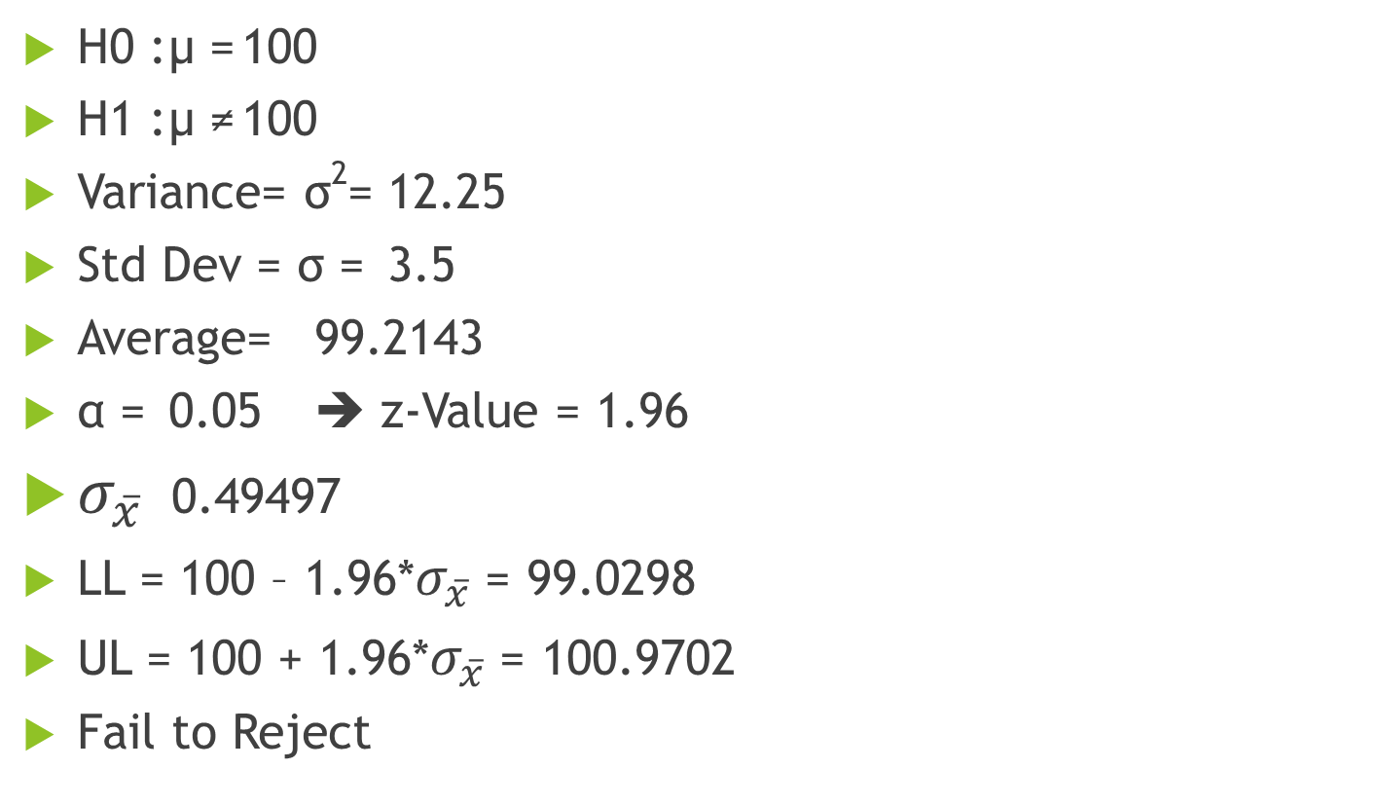
Case: Is Medworld Cheating?
H0 : µ = 100
H1 : µ ≠ 100
Variance= σ²= 12.25
Std Dev = σ = 3.5
Average= 99.2143
α = 0.05 ➔ z-Value = 1.96
$σ_{\overline{x}}$ 0.49497
LL = 100 – 1.96*$σ_{\overline{x}}$= 99.0298
UL = 100 + 1.96*$σ_{\overline{x}}$= 100.9702
Fail to Reject
Sample mean lies between the two limits

Slide 10
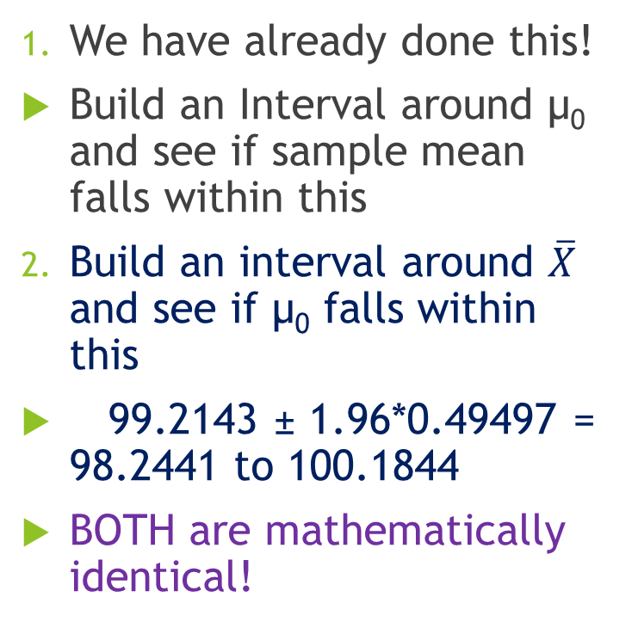


Three other ways to Test the Hypothesis
We have already done this!
Build an Interval around µ₀ and see if sample mean falls within this
Build an interval around $\overline{X}$ and see if µ₀ falls within this
99.2143 ± 1.96*0.49497 = 98.2441 to 100.1844
BOTH are mathematically identical!
99.0298
100.9702
$$2×1.96×σ_{\overline{X}}$$
$$2×1.96×σ_{\overline{X}}$$
99.2143

Slide 11
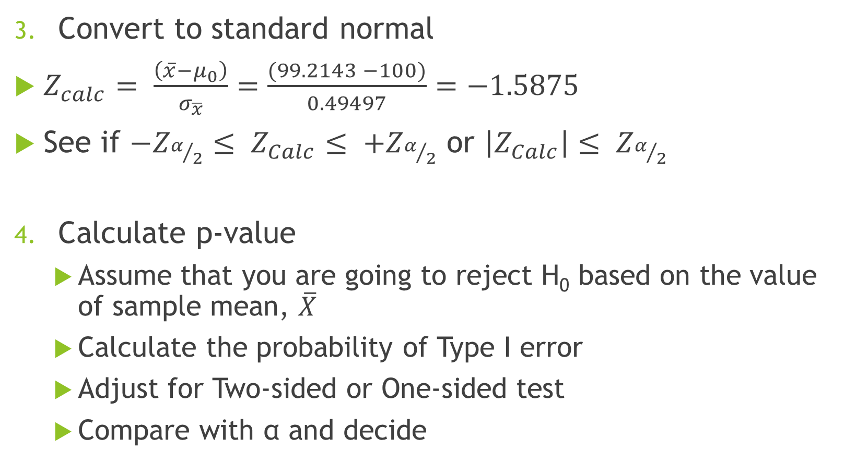
Three other ways (Continued)
Convert to standard normal
$Z_{calc}= \frac{\left(\overline{x}−μ_{0}\right)}{σ_{\overline{x}}}=\frac{(99.2143 −100)}{0.49497}=−1.5875$
See if $−Z_{α/2}≤ Z_{Calc}≤ +Z_{α/2}$ or $\left|Z_{Calc}\right|≤ Z_{α/2}$
Calculate p-value
  Assume that you are going to reject H₀ based on the value of sample mean, $\overline{X}$
  Calculate the probability of Type I error
  Adjust for Two-sided or One-sided test
  Compare with α and decide

Slide 12

Calculation of p-value
$\overline{X}=$99.2143

Slide 13
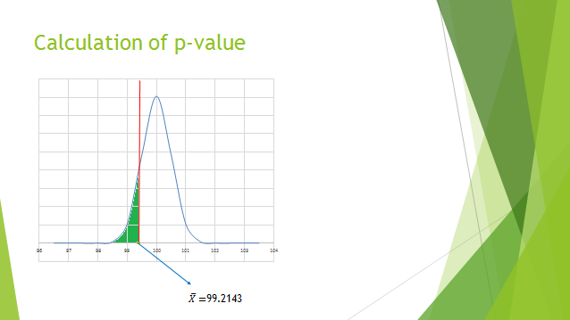
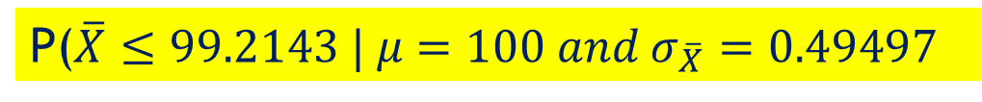
P($\overline{X}≤99.2143 | μ=100 and σ_{\overline{X}}=0.49497$
0.0562
P-value = 0.0562*2=0.1124
Which is greater than 0.05 (α)
Hence do not reject H₀

Slide 14
Hypothesis Test – Step by Step
State the null and alternate hypotheses (with respect to the population parameter)
Set the value of α (level of significance)
Identify the “sample estimator” corresponding to the population parameter
Identify the probability distribution (sampling distribution) of the estimator
Calculate the decision rule (Rejection Region)
Decide on the sample size
Collect data, calculate the estimator and TEST
Draw conclusions

Slide 15
Bending of Belmadi

Slide 16
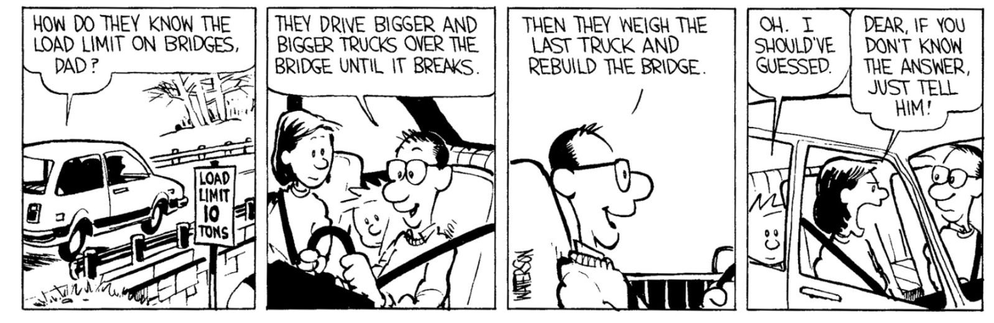
Bending of Belmadi

Slide 17
Bending of Belmadi: Two ways of setting up Null Hypothesis
Method A
Method B
H₀: μ ≥ 87 KIPS
H₁: μ < 87 KIPS
Type I error: Reject H₀ when “it is true” – minimize α
Implication: The bridge is actually safe, but we will ask the contractor to strengthen the bridge!
Unnecessary cost to the contractor
Type II error: Accept H₀ when “it is NOT true” – minimize β
Implication: Bridge is UNSAFE, but we will allow traffic
Loss of life; legal cases
H₀: µ ≤ 87 KIPS
H₁: μ > 87 KIPS
Type I error: Reject H₀ when “it is true” – minimize α
Implication: Bridge is UNSAFE, but we will allow traffic
Loss of life; legal cases
Type II error: Accept H₀ when “it is NOT true” – minimize β
Implication: The bridge is actually safe, but we will ask the contractor to strengthen the bridge!
Unnecessary cost to the contractor

Slide 18

Bending of Belmadi: Calculation of Rejection Regions
Mean= | 87.43
Var= | 42.25
S= | 6.5
 | 1.0833
n = | 36
α value | t-value
0.05 | 1.6896
0.01 | 2.4377
0.005 | 2.7238
0.001 | 3.3400
$S_{\overline{X}}$=
Method A
Method B
α | Cut-off
0.05 | 85.17
0.01 | 84.36
0.005 | 84.05
0.001 | 83.38
α | Cut-off
0.05 | 88.83
0.01 | 89.64
0.005 | 89.95
0.001 | 90.62

Slide 19
Conclusion?

Slide 20
Is Medworld Cheating?
Data
99.85 | 96.33 | 107.2 | 96.81 | 100.32 | 99.45 | 95.81 | 97.2 | 96.82 | 101.57
98.53 | 97.19 | 96.53 | 103.2 | 95.68 | 97.78 | 106.87 | 104.58 | 101.95 | 103.81
98.43 | 93.06 | 103.69 | 94.98 | 103.26 | 97.63 | 97.09 | 96.85 | 93.36 | 100.08
98.73 | 102.26 | 103.28 | 97.47 | 99.25 | 99.63 | 98.26 | 102.25 | 100.86 | 98.92
95.5 | 100.15 | 99.77 | 101.13 | 97.83 | 98.24 | 98.23 | 98.27 | 100.76 | 100.01
Proportion of tablets with less than 100mg = 0.62

Slide 21
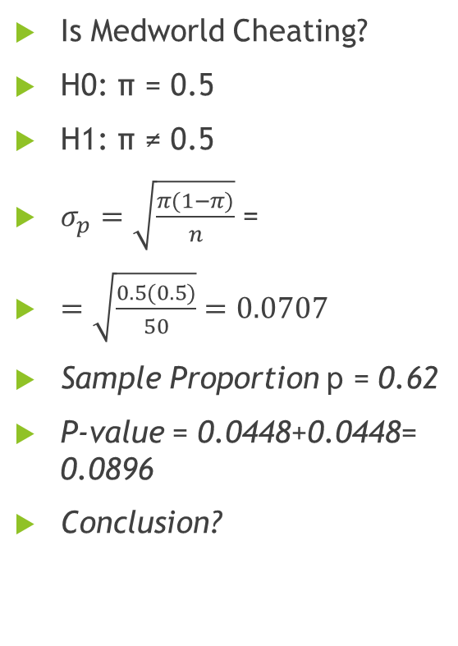
Hypothesis Test – Proportion
Is Medworld Cheating?
H0: π = 0.5
H1: π ≠ 0.5
$σ_{p}=\sqrt{\frac{π(1−π)}{n}}$ =
$=\sqrt{\frac{0.5(0.5)}{50}}=\text{0.0707}$
Sample Proportion p = 0.62
P-value = 0.0448+0.0448= 0.0896
Conclusion?
0.0448
0.0448

Slide 22
Example: Spam Filter
A small company is considering buying a commercial filtering software costing $15,000 per annum that the vendor claims will significantly reduce spam.
The company believes that if the software can reduce spam to less than 20% of the mails in the inbox, then it is worth the cost because of improved employee productivity.
The company collected a simple random sample of 100 mails in the inbox with the new filtering software in place and found that 11 of them were spam.
Should it buy the software? Assume that the significance level is α = 0.05.
Notes:
Agenda for Session 6A
Recap (what is stronger evidence; method of solving the problem) – 20 min
Proportions (spam filter) – 30 min
Break – 5 min
Two tailed test (process control) – 30 min
Midterm summary – 15 min
Correlation and covariance – 30 min
22

Slide 23
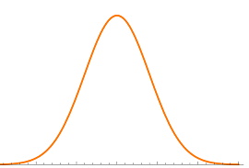


Left-tailed hypothesis test (sample proportion of 0.11)
Null Hypothesis: The software cannot reduce the spam filter rate to less than 20%
H0: π ≥ π₀ (0.20)
Acceptable level of type-I error is 0.05
(α = 0.05)
$$\sqrt{\frac{0.2(1−0.2)}{100}}=0.04$$
p-value = 0.01
0
$$z=\frac{0.11−0.20}{0.04}=−2.25$$
Probability of seeing a sample of 0.11 or less if π ≥ 0.20 is 0.01, which is less than 0.05
Buy the spam filter software

Slide 24
Breaking the Windshields - 1
C
Krishna Kant’s Wind Shields
H₀: µ ≥ 500 psi
H₁: µ < 500 psi
σ = 50 psi
Current Supplier:
µ = 470
Is this an “appropriate Alternate” value for µ for H₁?
α = 0.10
10%

Slide 25
Breaking the Windshields – 2
C
Calculation of β
5%

Slide 26
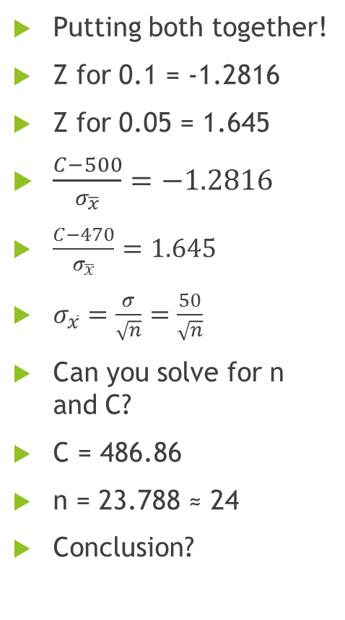
Breaking the Windshields – 3
Putting both together!
Z for 0.1 = -1.2816
Z for 0.05 = 1.645
$\frac{C−500}{σ_{\overline{x}}}=−1.2816$
$\frac{C−470}{σ_{\overline{x}}}=1.645$
$σ_{\overline{x}}=\frac{σ}{\sqrt{n}}=\frac{50}{\sqrt{n}}$
Can you solve for n and C?
C = 486.86
n = 23.788 ≈ 24
Conclusion?
C
10%
5%

Slide 27
Summary of Session
How and when to formulate hypotheses about population parameters?
Hypothesis is a provisional statement about a population parameter that is subject to a test and rejection based on evidence
Hypothesis test is applicable when the manager has specific position on a population parameter which needs to be rejected in order to take action
Strength of the evidence is calculated as the probability of finding such and stronger evidence if the null hypothesis is true and is called p-value
If p-value is less than α-value (the level of significance), the manager deems the evidence to be strong enough, rejects the null hypothesis and takes appropriate action
Given the uncertainty, we can never reject or not reject a hypothesis with certainty
  Type I error – Null hypothesis is true but you reject it based on “unusual” sample
  Type II error – Null hypothesis is not true but you accept it based on “usual” sample
  P(Type I error) = p-value
  P(Type-II error) ≠1 – P(Type-I error)
How to quantify the strength of the evidence?
What are Type I and Type II errors ?

Slide 28
Questions?
Clarifications?

